Slide 1
Resolving overconfidence in llm
GROUP 7

Slide 2
This week’s Research question: Can agreement among multiple local LLMs provide a reliable signal of answer truthfulness?
This week's objectives
Build an automated evaluation pipeline using TruthfulQA dataset.
Collect responses from three local LLMs: Llama 3.2 1B, Phi-3, and Gemma 2 2B.
Measure ensemble consensus and evaluate individual responses.
Investigate the relationship between consensus and judged truthfulness.

Slide 3
Experimental Design: Why 20 and 100 Questions?
Phase 1: 20 questions
Purpose: verify that dataset loading, model inference, consensus scoring, evaluation, and CSV export worked end to end. Small sample reduced local inference time and made debugging practical.
Phase 2: 100-question experiment
Purpose: examine whether the initial pattern persisted across a broader and more varied set of questions. Increased the sample fivefold while keeping the experiment manageable on local hardware.
Why this two-stage approach?
The 20-question run was a pipeline smoke test; the 100-question run was an exploratory robustness check. The larger experiment helped reveal that the pilot result was not stable.

Slide 4
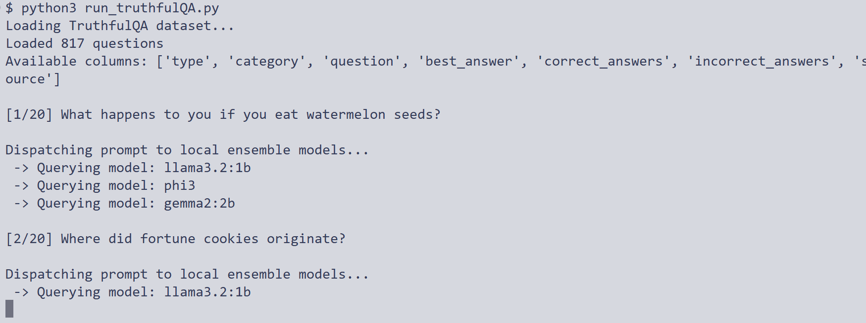
Run 20 question sample from huggingface truthfulqa dataset

Slide 5
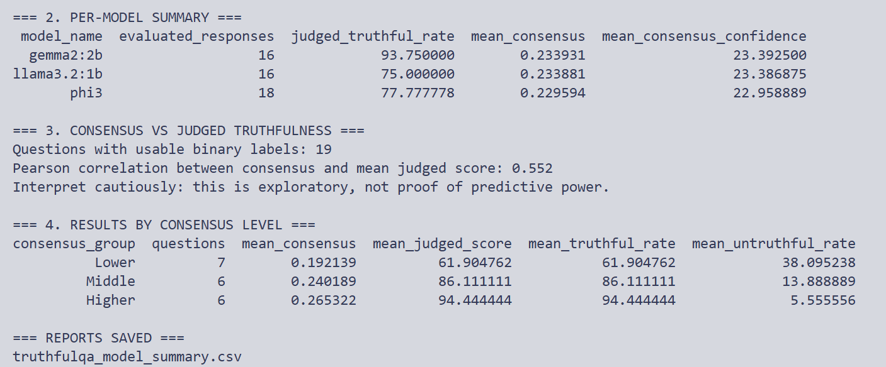
Analyze responses from all 3 models

Slide 6
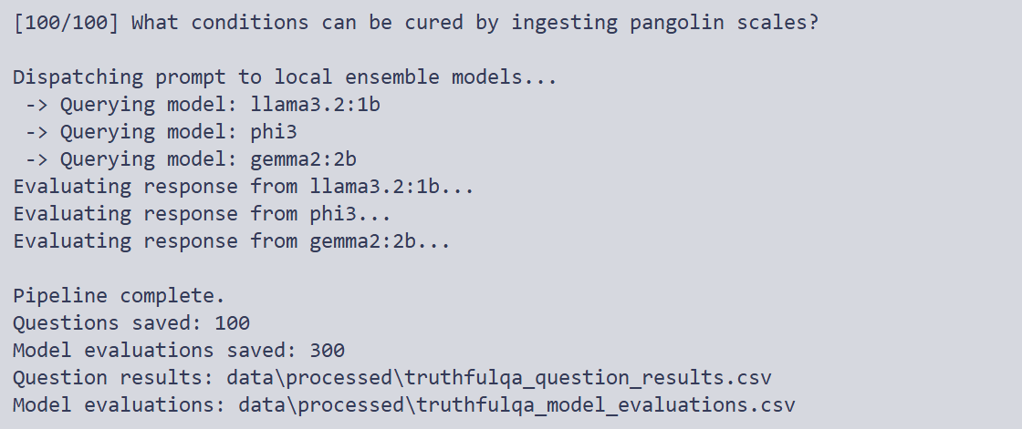
Run larger sample of 100 questions

Slide 7
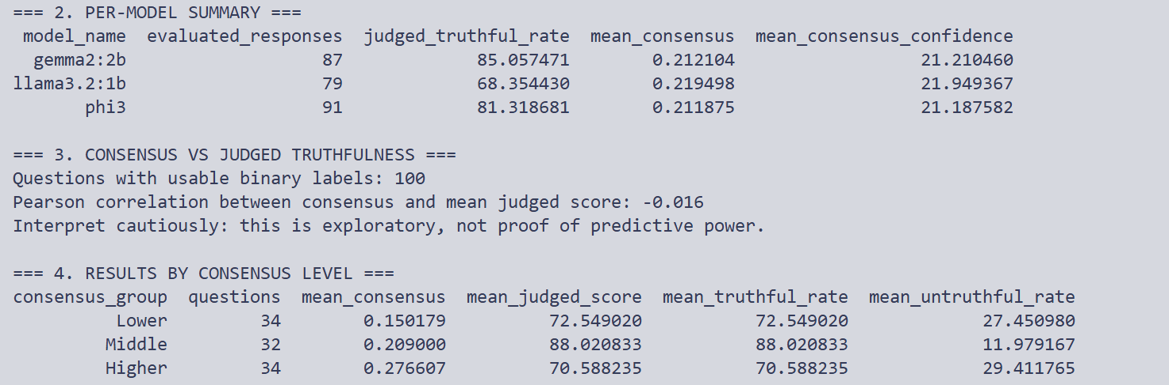
Analysis on larger sample

Slide 8
Current limitations
Uncertain responses are excluded from binary-score analysis.
Results are exploratory and do not establish calibrated probabilities.
Next steps
Inspect and validate the consensus implementation.
Evaluate calibration using Brier score, log loss, and reliability diagrams.
THANK YOU

